Slide 1

Automotive Technology:
A Systems Approach, 8e
Chapter 6: Diagnostic Equipment and Special Tools
Rob Thompson and Jack Erjavec, Automotive Technology: A Systems Approach, 8th Edition. © 2025 Cengage. All Rights Reserved. May not be scanned, copied or duplicated, or posted to a publicly accessible website, in whole or in part.

Slide 2
Chapter Objectives (1 of 2)
06.01 Describe the various diagnostic and service tools used to check and repair an engine and its related systems.
06.02 Describe the various diagnostic tools and service tools used to check and repair electrical and electronic systems.
06.03 Describe the various diagnostic and service tools used to check and repair engine performance systems.

Slide 3
Chapter Objectives (2 of 2)
06.04 Describe the various diagnostic and service tools used to check and repair hybrid vehicles.
06.05 Describe the various diagnostic and service tools used to check and repair a vehicle’s drivetrain.
06.06 Describe the various diagnostic and service tools used to check and repair a vehicle’s running gear.
06.07 Describe the various diagnostic and service tools used to check and repair a vehicle’s heating and air-conditioning system.

Slide 4
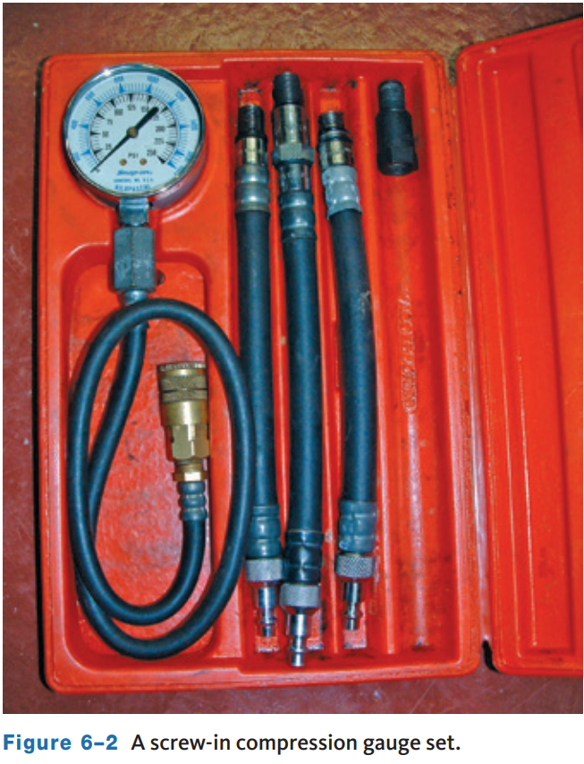
Compression Tester
06.01 Describe the various diagnostic and service tools used to check and repair an engine and its related systems.
Used to check cylinder compression while the engine is cranked or running.
The operation of an engine depends on the compression of the air–fuel mixture within its cylinders.
If the combustion chamber leaks, some of the mixture will escape while it is being compressed, resulting in a loss of power and a waste of fuel.
Installed into spark plug hole, or glow plug hole for diesel.

Slide 5
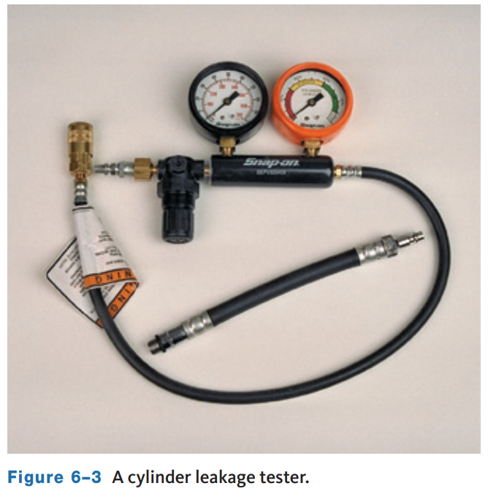
Cylinder Leakage Tester
A cylinder leakage tester applies compressed air through the spark plug hole into the cylinder.
The gauge registering air pressure lost from the cylinder and reads 0 percent to 100 percent.
A zero reading means there is no leakage in the cylinder.
A reading of 100 percent indicates that the cylinder will hold zero pressure.
The location of the compression leak can be found by listening and feeling around various parts of the engine.

Slide 6
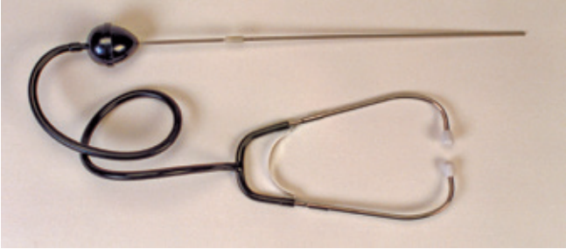
Stethoscope
A stethoscope is used to locate the source of engine and other noises.
Can also distinguish between normal and abnormal sounds.
It amplifies sound.
The stethoscope pickup is placed on the suspected component, and the stethoscope’s receptacles are placed in the technician’s ears.

Slide 7
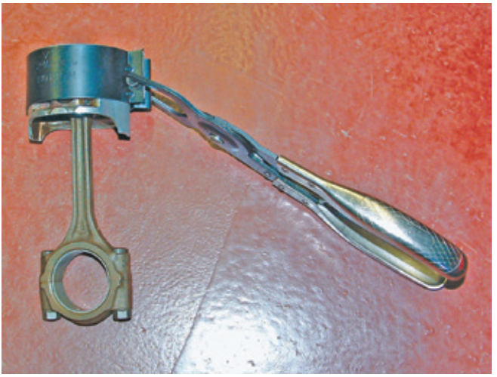
Piston Ring Compressor
It is used to install a piston into a cylinder bore.
There are three basic types.
  One style has an adjustable band with a ratchet mechanism to tighten it around the piston.
  Another uses ratcheting pliers to tighten a steel band around the piston.
  The third type has a single band that is wrinkled.

Slide 8
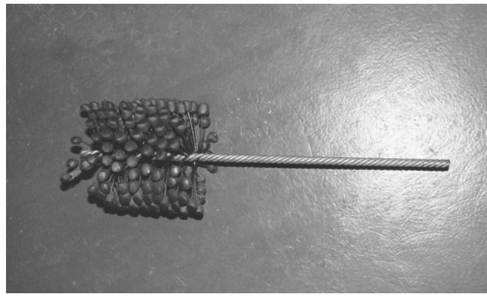
Cylinder Hone and Deglazer
The proper surface finish on a cylinder wall is important as it acts as a reservoir for oil to lubricate the piston rings and prevent piston and ring scuffing.
Honing sands the walls to remove imperfections. A cylinder hone usually consists of two or three stones.
The hone rotates at a selected speed and is moved up and down the cylinder’s bore.
Honing oil flows over the stones and onto the cylinder wall to control the temperature and flush out any metallic and abrasive residue.

Slide 9
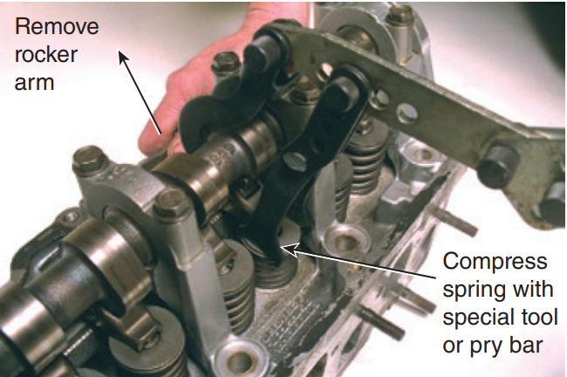
Valve Spring Compressor
To remove valves from a cylinder head, the valve spring must be compressed enough to remove the valve keepers, then the retainer. There are many types of valve spring compressors.
Some are designed to allow valve spring removal while the cylinder head is still on the engine block. In this case, compressed air is supplied to the cylinder on the compression stroke to hold the valves from falling into the cylinder.
Other designs are only used when the cylinder head is removed.

Slide 10
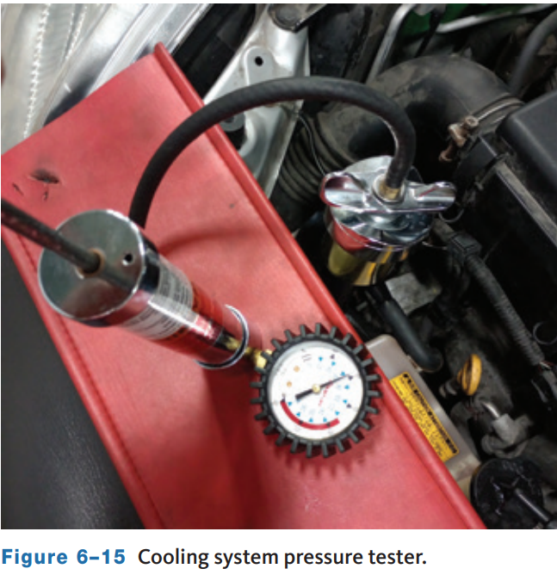
Cooling System Pressure Tester
Used to pressurize the cooling system and check for coolant leaks.
It contains a hand pump and a pressure gauge.
A hose is connected from the hand pump to an adapter that fits on the radiator filler neck.
Additional adapters are available to connect the tester to the radiator or the radiator cap.

Slide 11
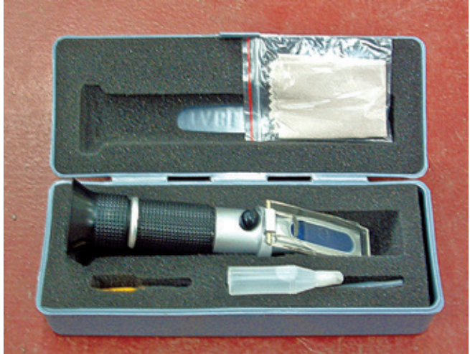
Coolant Hydrometer and Refractometer
Coolant Hydrometer
  A coolant hydrometer is used to check the amount of antifreeze in the coolant which indicates is freeze protection.
  This tester contains a pickup hose, a coolant reservoir, and a squeeze bulb.
Refractory Testers
  For many shops, the preferred way to check coolant is with a refractometer.

Slide 12
Other Engine Repair Tools
Ring Expander
Ring Groove Cleaner
Dial Bore Indicator
Cam Bearing Driver Set
V-Blocks
Valve and Valve Seat Resurfacing Equipment
Valve Guide Repair Tools
Valve Spring Tester
Torque Angle Gauge

Slide 13
Discussion
You have learned about the basic function of a cylinder leakage tester.
Have a class discussion about how you would use this tool and how you would locate compression leaking at the:
  Intake valve
  Exhaust valve
  Piston or piston rings
  Head gasket

Slide 14
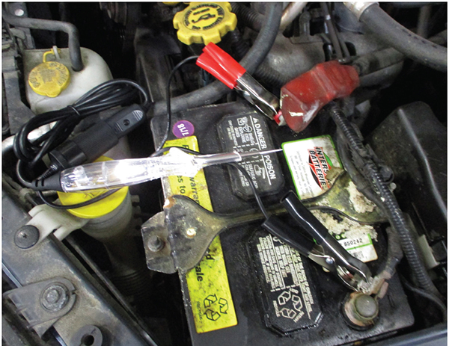
Circuit Tester
06.02 Describe the various diagnostic tools and service tools used to check and repair electrical and electronic systems.
They are used to check for voltage in an electrical circuit.
Commonly called a test light, looks like a stubby ice pick.
A probe extends from one end of the handle and a ground clip and wire from the other end.

Slide 15
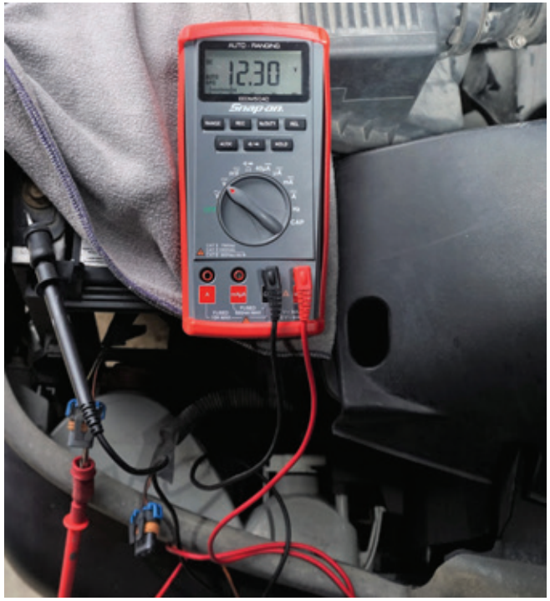
Multimeters
A multimeter is a must for diagnosing the individual components of an electrical system.
A volt-ohm-milliamp meter is referred to as a VOM or DVOM if it is digital. A digital multimeter (DMM) can measure many more things than volts, ohms, and low current.
Most multimeters (Figure 6–20) measure direct current (DC) and alternating current (AC) amperes, volts, and ohms.
More advanced multimeters may also measure diode continuity, frequency, temperature, engine speed, dwell and/or duty cycle.

Slide 16
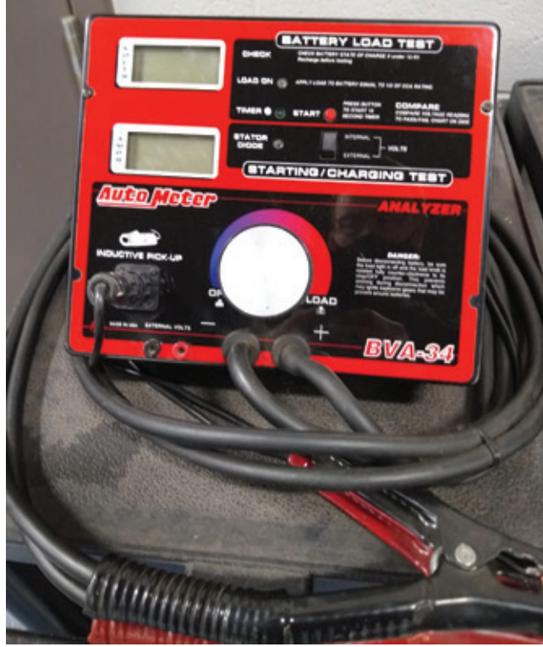
Volt/Ampere Tester
A volt/ampere tester (VAT) is used to test batteries, starting systems, and charging systems.
The tester contains a voltmeter, ammeter, and carbon pile.
The carbon pile is a variable resistor.
A VAT also measures the current draw of the starter and current output from the charging system.

Slide 17
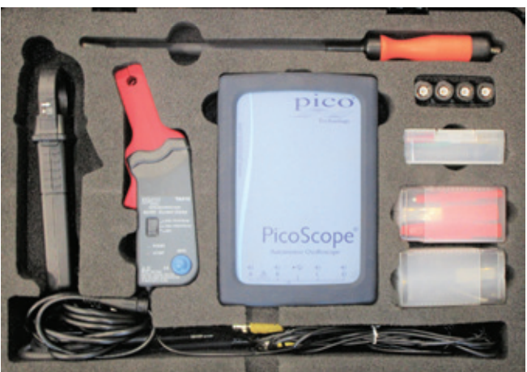
Lab Scopes
An oscilloscope or lab scope is a visual voltmeter.
It converts electrical signals to a visual image representing voltage changes over a period of time.
This information is displayed in the form of a continuous voltage line called a waveform or trace.
A scope displays any change in voltage as it occurs.

Slide 18
Other Electrical/Electronic System Tools
Computer Memory Saver
Voltmeter
Ammeter
Ohmmeter
Battery Capacitance Tester
Graphing Multimeter
Wire and Terminal Repair Tools
Headlight Aimers

Slide 19
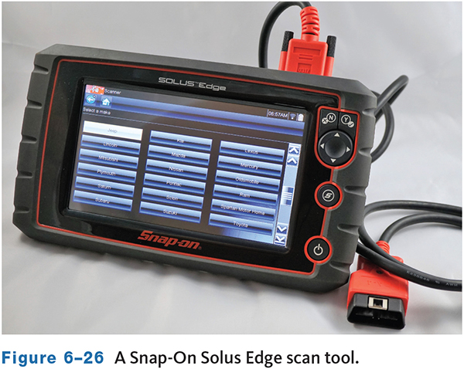
Scan Tools
06.03 Describe the various diagnostic and service tools used to check and repair engine performance systems.
A scan tool is a computer designed to communicate with the vehicle’s computers.
Connected to the electronic control system through diagnostic connectors, a scan tool can access diagnostic trouble codes (DTCs), run tests to check system operations, and monitor the activity of the system.
The scan tool is connected to specific diagnostic connectors on the vehicle.

Slide 20
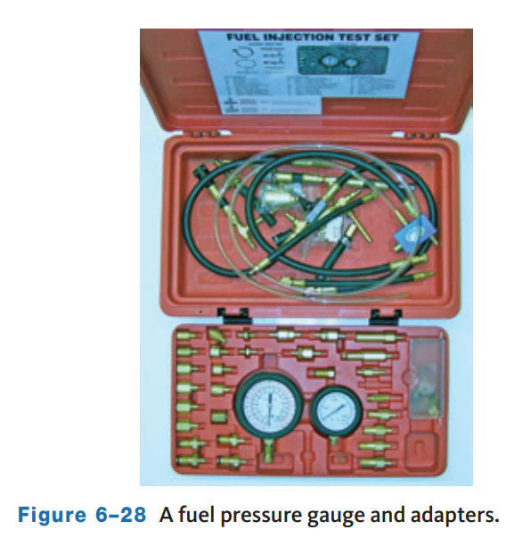
Fuel Pressure Gauge
Fuel pressure gauge is used to check the discharge pressure of fuel pumps, the regulated pressure of fuel injection systems, and injector pressure drop.
These systems rely on fuel pressures, from 35 to 70 psi.
A drop in fuel pressure reduces the amount of fuel delivered to the injectors and results in a lean air–fuel mixture.

Slide 21
Knowledge Check (1 of 2)
  When using a scan tool, where would it be connected to begin communication with the vehicle computers?

Slide 22
Knowledge Check Answer (1 of 2)
  When using a scan tool, where would it be connected to begin communication with the vehicle computers?
  Answer: The scan tool is connected to specific diagnostic connectors on the vehicle.

Slide 23
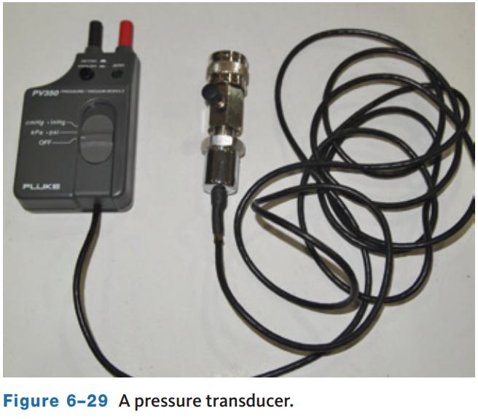
Pressure Transducer
It measures pressure and changes it into an electrical signal so it can be displayed on a lab scope of graphing DMM.
A pressure transducer can measure such things as:
  Fuel pressure, oil pressure, exhaust pressure, intake pressure (vacuum), crankcase pressure, radiator pressures, and cylinder compression.
A fuel pressure transducer connects to the Schrader valve on the fuel rail.

Slide 24
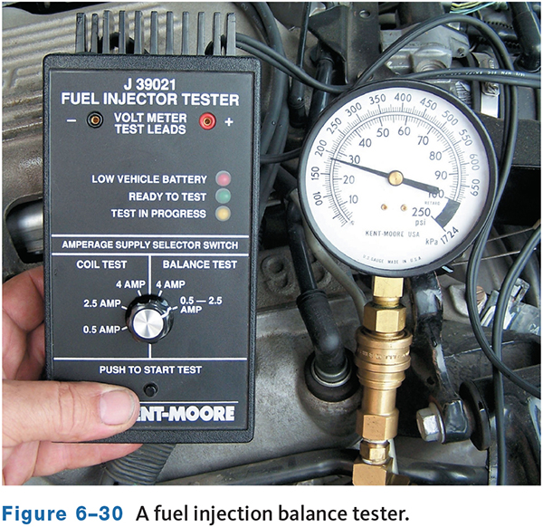
Injector Balance Tester
The tester leads are attached to the injector terminals.
The fuel pressure gauge is connected to the fuel rail, and fuel pressure is shown on the pressure gauge.
The tester energizes the injector for a specific length of time, and the technician records the pressure decrease on the fuel pressure gauge.
If the pressure drops little, or if there is no pressure drop, the injector’s orifice is restricted or the injector is faulty.
If there is an excessive amount of pressure drop, the injector plunger is sticking open, which results in a rich air-fuel mixture.

Slide 25
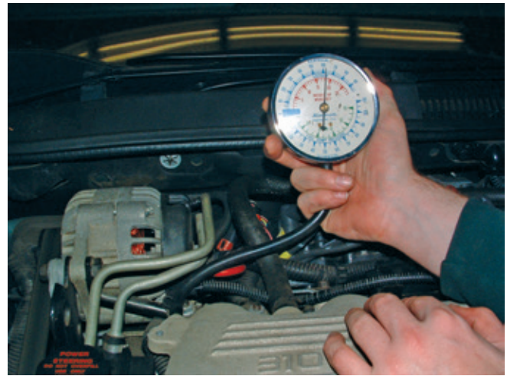
Vacuum Gauge
Measuring intake manifold vacuum can diagnose the condition of an engine.
To measure vacuum, a hose on the vacuum gauge is connected to a source of manifold vacuum, either on the manifold or at a point below the throttle plates.
The test is made with the engine cranking or running. A good vacuum reading is typically at least 16 in. Hg. However, a reading of 15 to 20 in. Hg (50 to 65 kPa) is normally acceptable.

Slide 26
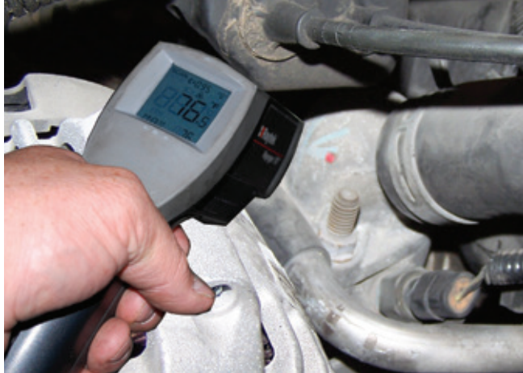
Pyrometers
A pyrometer is an electronic device that measures temperature.
These are used to:
  Check for blockages across the radiator.
  Measure temperatures on air-conditioning system lines, hoses, and condenser.
  Find dragging brakes.

Slide 27
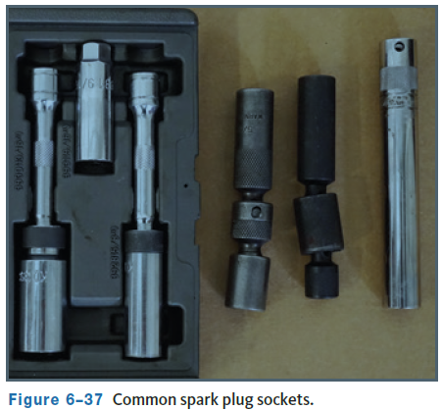
Spark Plug Sockets
Special sockets are available for the installation and removal of spark plugs.
These deep sockets have a hex nut drive at the end to allow a technician to turn them with a ratchet or an open-end wrench.
The sockets are available in the common sizes of spark plugs (5/8-inch, 9/16-inch, and 13/16-inch) and have a 3/8-inch drive.
The socket has a rubber sleeve that surrounds the insulator part of the spark plug to prevent cracking or other damage to the plug while it is being removed or installed.

Slide 28
Chassis Dynamometer
A chassis dynamometer, commonly called a dyno, is used to simulate a road test.
A vehicle can be driven through a wide assortment of operating conditions without leaving the shop.
Because the vehicle is stationary, test equipment can be connected and monitored while the vehicle is driven under various loads. This is extremely valuable when diagnosing a problem.
A chassis dyno can also be used for performance tuning.
Some performance shops have an engine dynamometer that directly measures the output from an engine while the chassis dyno measures the engine output after it has passed through the driveline.

Slide 29
Other Pressure Transducers
Injector Circuit Test light
Fuel Injector Cleaners
Fuel Line Tools
Pinch-Off Pliers
Vacuum Leak Detector
Vacuum Pump
Spark Tester
Tachometer
Logic Probes
Sensor Tools

Slide 30
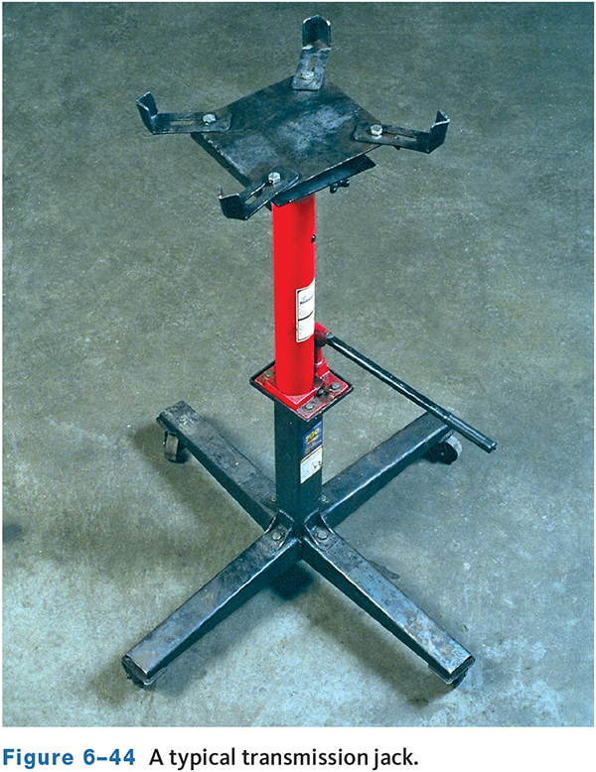
Transmission and Driveline Tools (1 of 2)
Transmission Jack
  It is designed to help you while removing a transmission from under the vehicle.
  The transmission’s weight makes it difficult and unsafe to remove it without assistance and/ or a transmission jack.
  They are available in two basic styles.
    One is used when the vehicle is raised by a hydraulic jack and sitting on jack stands.
    The other style is used when the vehicle is raised on a lift.

Slide 31
Transmission and Driveline Tools (2 of 2)
Axle Pullers
  Axle pullers are used to pull rear axles in RWD vehicles.
Clutch Alignment Tool
  To keep the clutch disc centered on the flywheel while assembling the clutch, a clutch alignment tool is used.
Clutch Pilot Bearing/Bushing Puller/Installer
  To remove and install a clutch pilot bearing or bushing, special tools are needed.
Hydraulic Pressure Gauge Set
  It is a common diagnostic tool for automatic transmissions.

Slide 32
Other Transmission and Driveline Tools
Transaxle Removal and Installation Equipment
Transmission/Transaxle Holding Fixtures
Universal Joint Tools

Slide 33
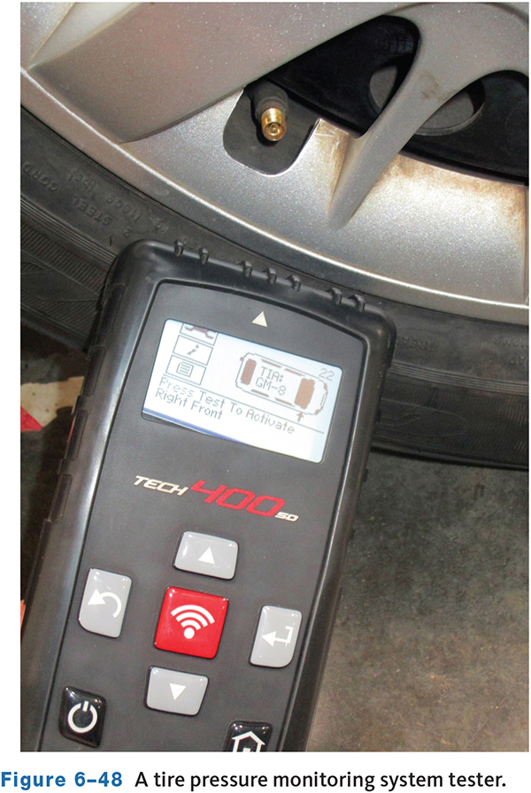
Suspension and Steering Tools (1 of 4)
Tire Pressure Monitoring (TPM) Tools
  These are required for checking and resetting TPM systems after service.
  The tool is also used to program a replacement tire pressure monitoring.
  TPM tool kits contain the special tools needed to service and replace TPMS.

Slide 34
Suspension and Steering Tools (2 of 4)
Tie-Rod End and Ball Joint Puller
  It can be used to remove tie-rod ends and pull ball joint studs from the steering knuckle.
Front Bearing Hub Tool
  They are designed to remove and install front wheel bearings on FWD cars.
Pitman Arm Puller
  A pitman arm puller is a heavy-duty puller designed to remove the pitman arm from the pitman shaft.

Slide 35
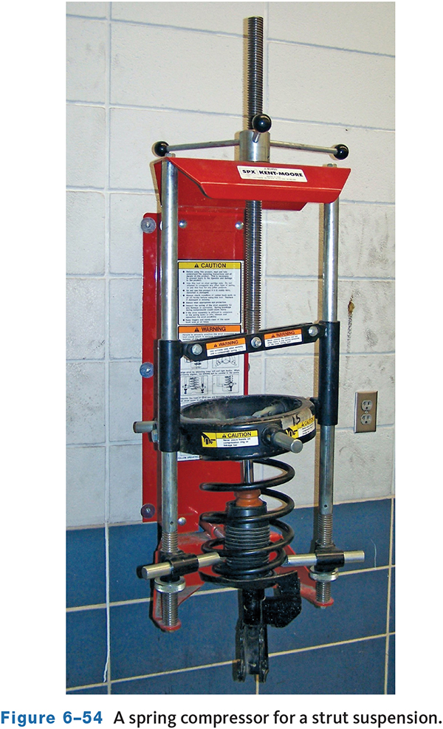
Suspension and Steering Tools (3 of 4)
Spring/Strut Compressor Tool
Many types of coil spring compressors are available.
These tools are designed to compress a coil spring and hold it in the compressed position while removing the spring from a short-long arm (SLA) suspension, removing the strut from the coil spring, or performing other suspension work.

Slide 36
Suspension and Steering Tools (4 of 4)
Tire Changer
  Tire changers are used to demount and mount tires.
Road Force Balancer
  Many shops have a wheel balancing machine that is a road force balancer. The primary purpose of the machine is to see if a wheel and tire assembly is round while it is rolling down the road.
Wheel Weight Pliers
  They are combination tools designed to install and remove clip-on lead wheel weights.

Slide 37
Other Suspension and Steering Tools
Tire Tread Depth Gauge
Power Steering Pressure Gauge
Control Arm Bushing Tool
Pitman Arm Puller
Steering Column Special Tool Set
Shock Absorber Tools
Power-Steering Pump Pulley Special Tool Set
Wheel Alignment Equipment—Four Wheel

Slide 38
Knowledge Check (2 of 2)
What is a pyrometer and what does it measure?

Slide 39
Knowledge Check Answer (2 of 2)
What is a pyrometer and what does it measure?
Answer: A pyrometer is an electronic device that measures temperature.

Slide 40
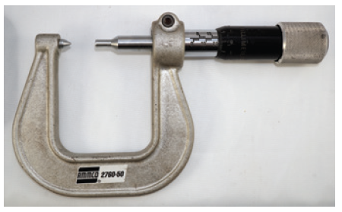
Brake System Tools (1 of 2)
Brake disc micrometer
A special micrometer is used to accurately check the thickness of a brake rotor.
A brake disc micrometer has pointed anvils that allow the tip to fit into grooves worn on the rotor.
This type of micrometer is read in the same way as other micrometers but it is made with a range from 0.200 to 1,100 inches.

Slide 41
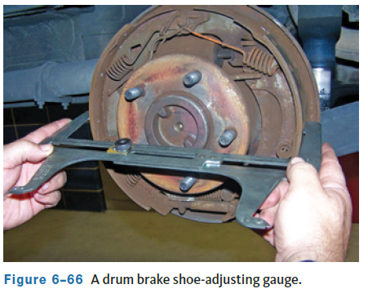
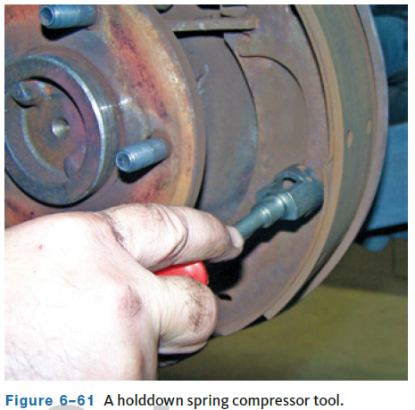
Brake System Tools (2 of 2)
Drum Brake Adjusting Tools
Although drum brakes have some type of selfadjuster, brake shoes still require an initial adjustment after they are installed.
The star wheel adjusters of many drum brakes can be adjusted with a flat-blade screwdriver. Brake-adjusting spoons and wire hooks designed for this specific purpose can make the job faster and easier.

Slide 42
Other Brake System Tools
Boot Drivers, Rings, and Pliers
Tubing Tools
Caliper Piston Removal Tools
Brake Shoe Adjusting Gauge (Calipers)
Brake Lathes

Slide 43
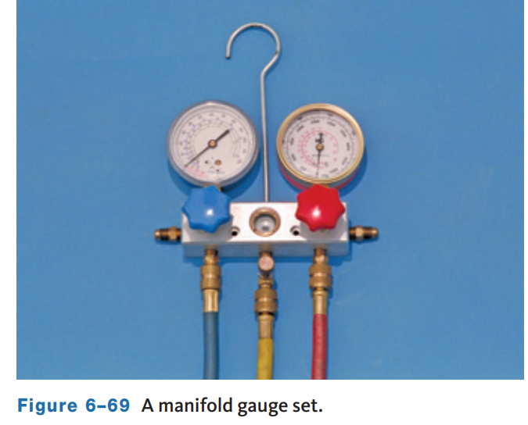
Heating and Air-Conditioning Tools (1 of 2)
Manifold Gauge Set
  It is used when discharging, charging, evacuating, and diagnosing an A/C system.
  The low-pressure gauge is graduated into pounds of pressure from 1 to 120 (with cushion to 250) in 1-pound graduations, and, in the opposite direction, in inches of vacuum from 0 to 30.
  The high-pressure gauge is graduated from 0 to 500 pounds pressure in 10-pound graduations.

Slide 44
Heating and Air-Conditioning Tools (2 of 2)
Electronic Leak Detector
  It is safe and effective and can be used with all types of refrigerants.
Fluorescent Leak Tracer
  To find a refrigerant leak using the fluorescent tracer system, a fluorescent dye is introduced into the air-conditioning system with a special infuser included with the detector equipment.
Refrigerant Identifier
  It is used to identify the type of refrigerant present in a system. This test should be done before any service work.

Slide 45
Other Heating and Air-Conditioning Tools
Bleeding Tools
Bleeder Screw Wrenches
Sealant Detection Kit
Compressor tools
Refrigerant Recycling/Charging Stations
Thermometer
Hose and Fitting Tools

Slide 46
Chapter Reflection
Please take a moment to compare your perception of the automotive industry before and after you studied this chapter. Then respond to the following questions in one or two paragraphs. Use 150–200 words in your reflection.
Did seeing the large number of different tools commonly used in automotive surprise you?
Considering that you have briefly discussed many of them, how do you plan to become familiar with each of these tools and equipment so you can be successful in your career?

